Slide 1
Online Hotel Booking System
Created by: Masud Rana
Trainee Id: 1277593
Batch: JEE/CCSL-M/55/01

Slide 2
Project Introduction
In the project two segment will be complete below these:
Hotel’s CAR PARKING RESERVATION
HOTEL ROOM BOOKING

Slide 3
IMPLEMENTATION OF CAR PARKING
User LogIn page
Manage Parking space page
Slots Page
Booking Page
Confirmation Booking page
Release Car Page

Slide 4
LIST OF TABLES OF CAR PARKING
User:
UserID (Primary Key)
FirstName
LastName
Email
Password
PhoneNumber
ParkingSpace:
ParkingSpaceID (Primary Key)
Name
Location
TotalSlots
Slot:
SlotID (Primary Key)
ParkingSpaceID (Foreign Key)
SlotNumber
AvailabilityStatus
Booking:
BookingID (Primary Key)
UserID (Foreign Key)
ParkingSpaceID (Foreign Key)
SlotID (Foreign Key)
CheckInDateTime
CheckOutDateTime
TotalCost
BookingStatus (confirmed, canceled)
Confirmation:
ConfirmationID (Primary Key)
BookingID (Foreign Key)
ConfirmationDateTime
ConfirmationCode
ConfirmationID

Slide 5
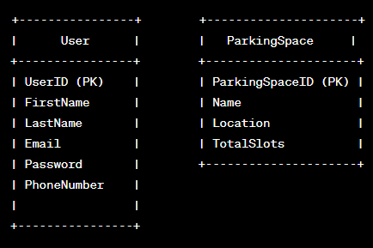
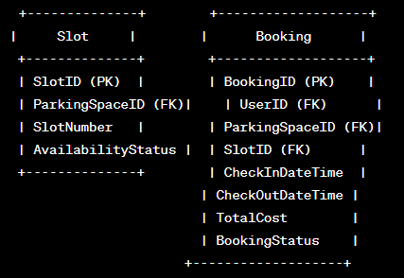
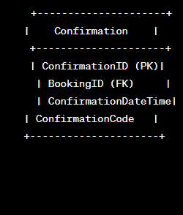
Database will be maintain in MYSQL for CAR PARKING
PK denotes Primary Key.
FK denotes Foreign Key, representing a link to the primary key of another table.

Slide 6
IMPLEMENTATION OF HOTEL BOOKING
As a Admin Activity
As a User Activity
Admin Login Page
Admin Menu Page
Change Price and Quantity Page
Change Room Information Page
View Users' Profiles Page
Create New Administrators Page
Change Users' Records Page
Cancel Users' Records Page
Change Contact us Page
Register Page
User Login Page
Main Page - Login Already
Booking Details Page
Room Information Page
Confirm Booking Page
Change Booking Details Page
Booking Updated Page
Price Details Page
Payment Page
Booking Completed Page
View Booking Details Page
Cancel Booking Determined
Booking Cancelled Page
View my Profile Page

Slide 7
LIST OF TABLES OF HOTEL BOOKING
User:
UserID (Primary Key)
FirstName
LastName
Email
Password
PhoneNumber
Booking:
BookingID (Primary Key)
UserID (Foreign Key)
RoomID (Foreign Key)
CheckInDate
CheckOutDate
TotalCost
BookingStatus (confirmed, pending, canceled)
Room:
RoomID (Primary Key)
RoomNumber
Type (single, double, suite)
PricePerNight
AvailabilityStatus
Profile:
ProfileID (Primary Key)
UserID (Foreign Key)
AdditionalProfileDetails
Admin:
AdminID (Primary Key)
AdminUsername
AdminPassword
AdminActivityLog:
LogID (Primary Key)
AdminID (Foreign Key)
ActivityType (login, change_price, change_quantity, etc.)

Slide 8
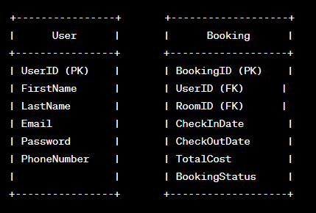
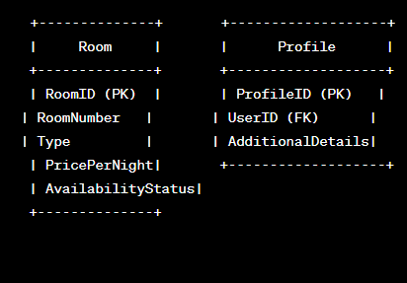
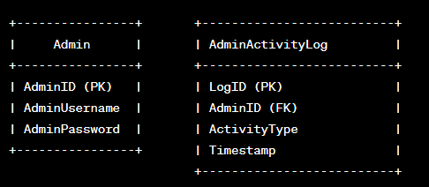
Database will be maintain in MYSQL for HOTEL BOOKING
PK denotes Primary Key.
FK denotes Foreign Key, representing a link to the primary key of another table.

